Slide 1

Radio Signal from Early Universe
Aryana Haghjoo
Notes:
Hello everyone and welcome to my presentation.

Slide 2
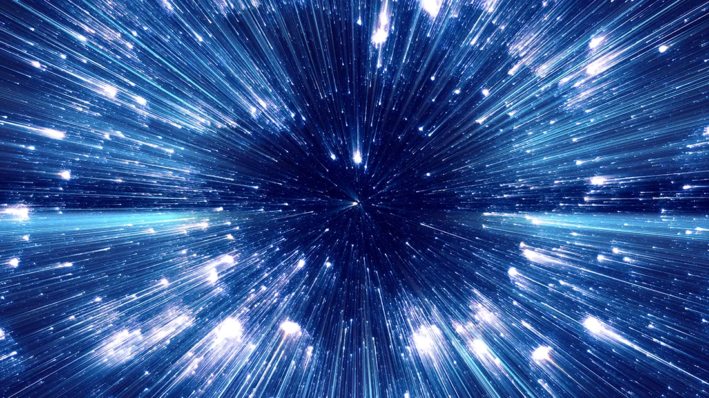

The Early Universe
?
Notes:
"Who knows what happened right after the big bang? No one, guess what:
My name is Aryana, I am a master’s student of cosmology, and I do not know too!
In fact, none of us exactly knows what happened!

Slide 3
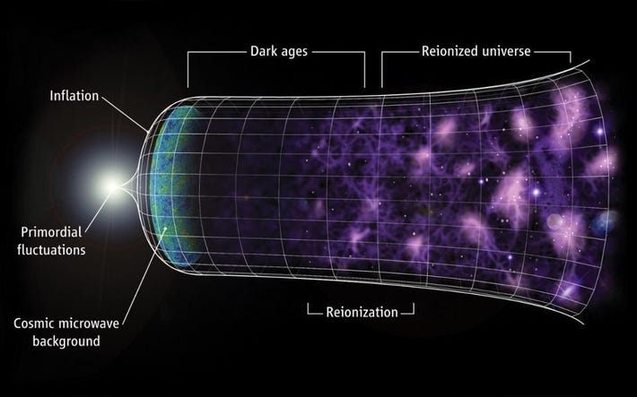
The Dark Ages
Notes:
14 billion years ago, with the universe completely cooled down after the explosion, there is no light in the universe, remember: there are no stars or galaxies yet! Within the cosmologist’s community, this era is called “The Dark Ages”! (Physicists are often not that creative when it comes to naming stuff 😊)
During these so-called “Dark Ages,” the universe is filled with huge clouds of gas, mostly from hydrogen and helium. Neutral atomic hydrogen in those clouds has a kind of special electromagnetic radiation (like the one our phones work with), which is a radio signal. Therefore, we call this the “radio signal of hydrogen” (because obviously, we can not find any better names!).

Slide 4
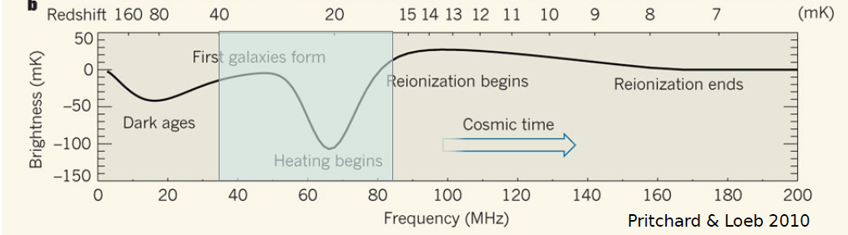
The Global Radio Signal (of Neutral Hydrogen)
Notes:
The existence of this radiation is predicted by our grand theoretical model: “The Standard Model of Cosmology” which works pretty well in most cases. The exciting thing about this radiation is that recently cosmologists have found this radiation is capable of giving us a lot of valuable information about the early universe Meaning how the early universe really looed like.
Look at this plot, the y-axis is the temperature of this signal in millikelvin, and the x-axis is the frequency. What is of most importance for us, is this second bump here. Because the end of this bump is the start of star and galaxy formation
Until recently, we did not have any observational detection from this signal. It is very hard to detect because it is very faint, and it is often wiped out with noise from mobile devices and other stuff like this. But, in 2017, a group of observational astrophysicists from Australia (called the EDGES group) reported the first-ever detection of this signal and guess what: they ruined theoretical cosmologists! And I am gonna tell you why!

Slide 5
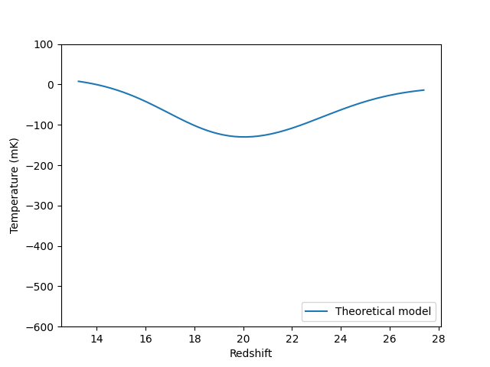
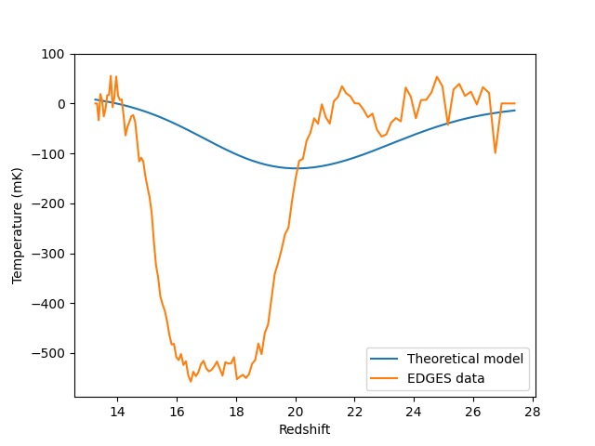
The EDGES data (2017)
Notes:
The reason that they were ruined was that :The shape of the signal was very different from what we expected form the Standard Model of Cosmology (change the slide), pause, meaning that either the data or the theory is problematic!
Look at this plot, again we have the y-axis as the temperature of this signal in millikelvin, and the x-axis is the redshift which is an equivalent definition for frequency, so you can just assume it to be frequency. The orange line shows what the theoretical predictions give us, and the blue curve is the data! You can see the huge difference in the shape and depth of the two curves. The meaning of this difference is that the gas in the early universe is much cooler than what we expected! The temperature of the universe is just way less!
This debate has not been solved up to now. Some people believe that this data is not reliable, but we do not have any other observational data to compare the two. Some people are trying to change the theory such that it fits the observed signal.
My part in this big picture, as a master’s student of physics, is that I am one of those people who try to check how our “Standard Model of Cosmology” should be changed to match the shape of the observed data.

Slide 6
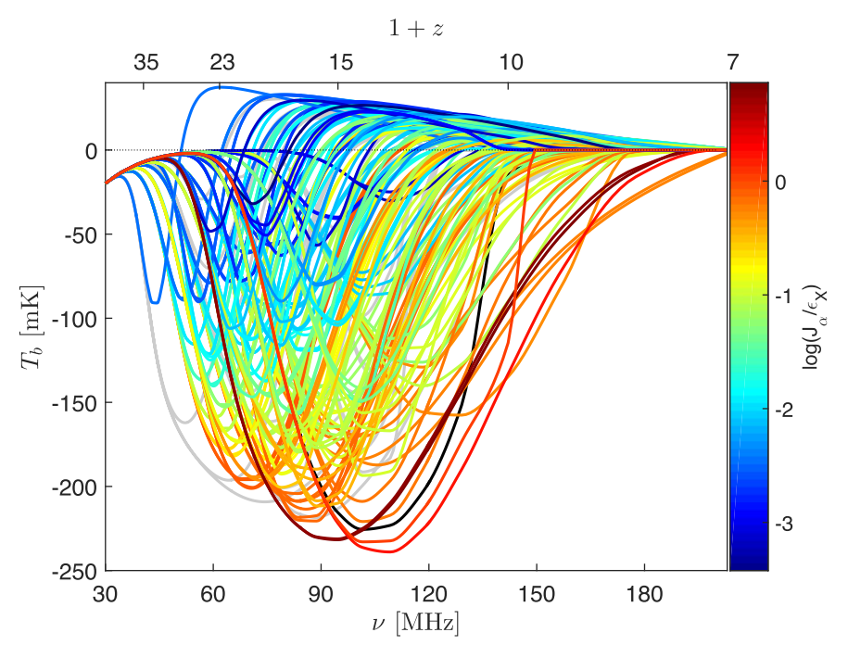
Different Astrophysical Scenarios
Cohen et al, 2016
Notes:
We know that certain astrophysical conditions may change the shape of this signal, so it becomes more like the data we observed. For example, if you had less stars being formed at that time of the universe, you will probably get a curve closer to the data. There exist a lot of different astrophysical parameters like this, you change each a little bit, and you get a different curve.
Look at this plot, It shows the global 21cm signal for 193 different astrophysical scenarios.
What I exactly do is that I look at all these curves and I search for one which gives the most probable story of our universe if we accept the data to be correct.

Slide 7
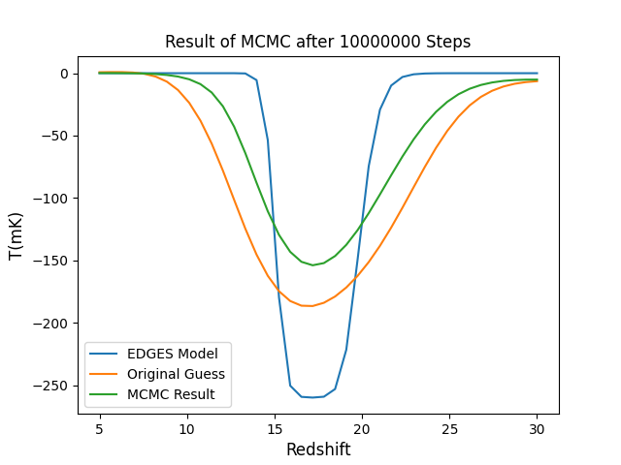
Markov Chain Monte Carlo
Notes:
There are some formal computational methods to find out which scenario is the most probable one. You may have heard about some of them like neural networks and machine learning. I use an algorithm called Markov Chain Monte Carlo (MCMC) which is able to tell me how should the situation in the early universe evolves if we are to get that data. It just searches through all different curves and find the one with the highest probability.
This is one of the best results that I have had till now, the green curve. Which, as you can see, is still very far from the data.

Slide 8
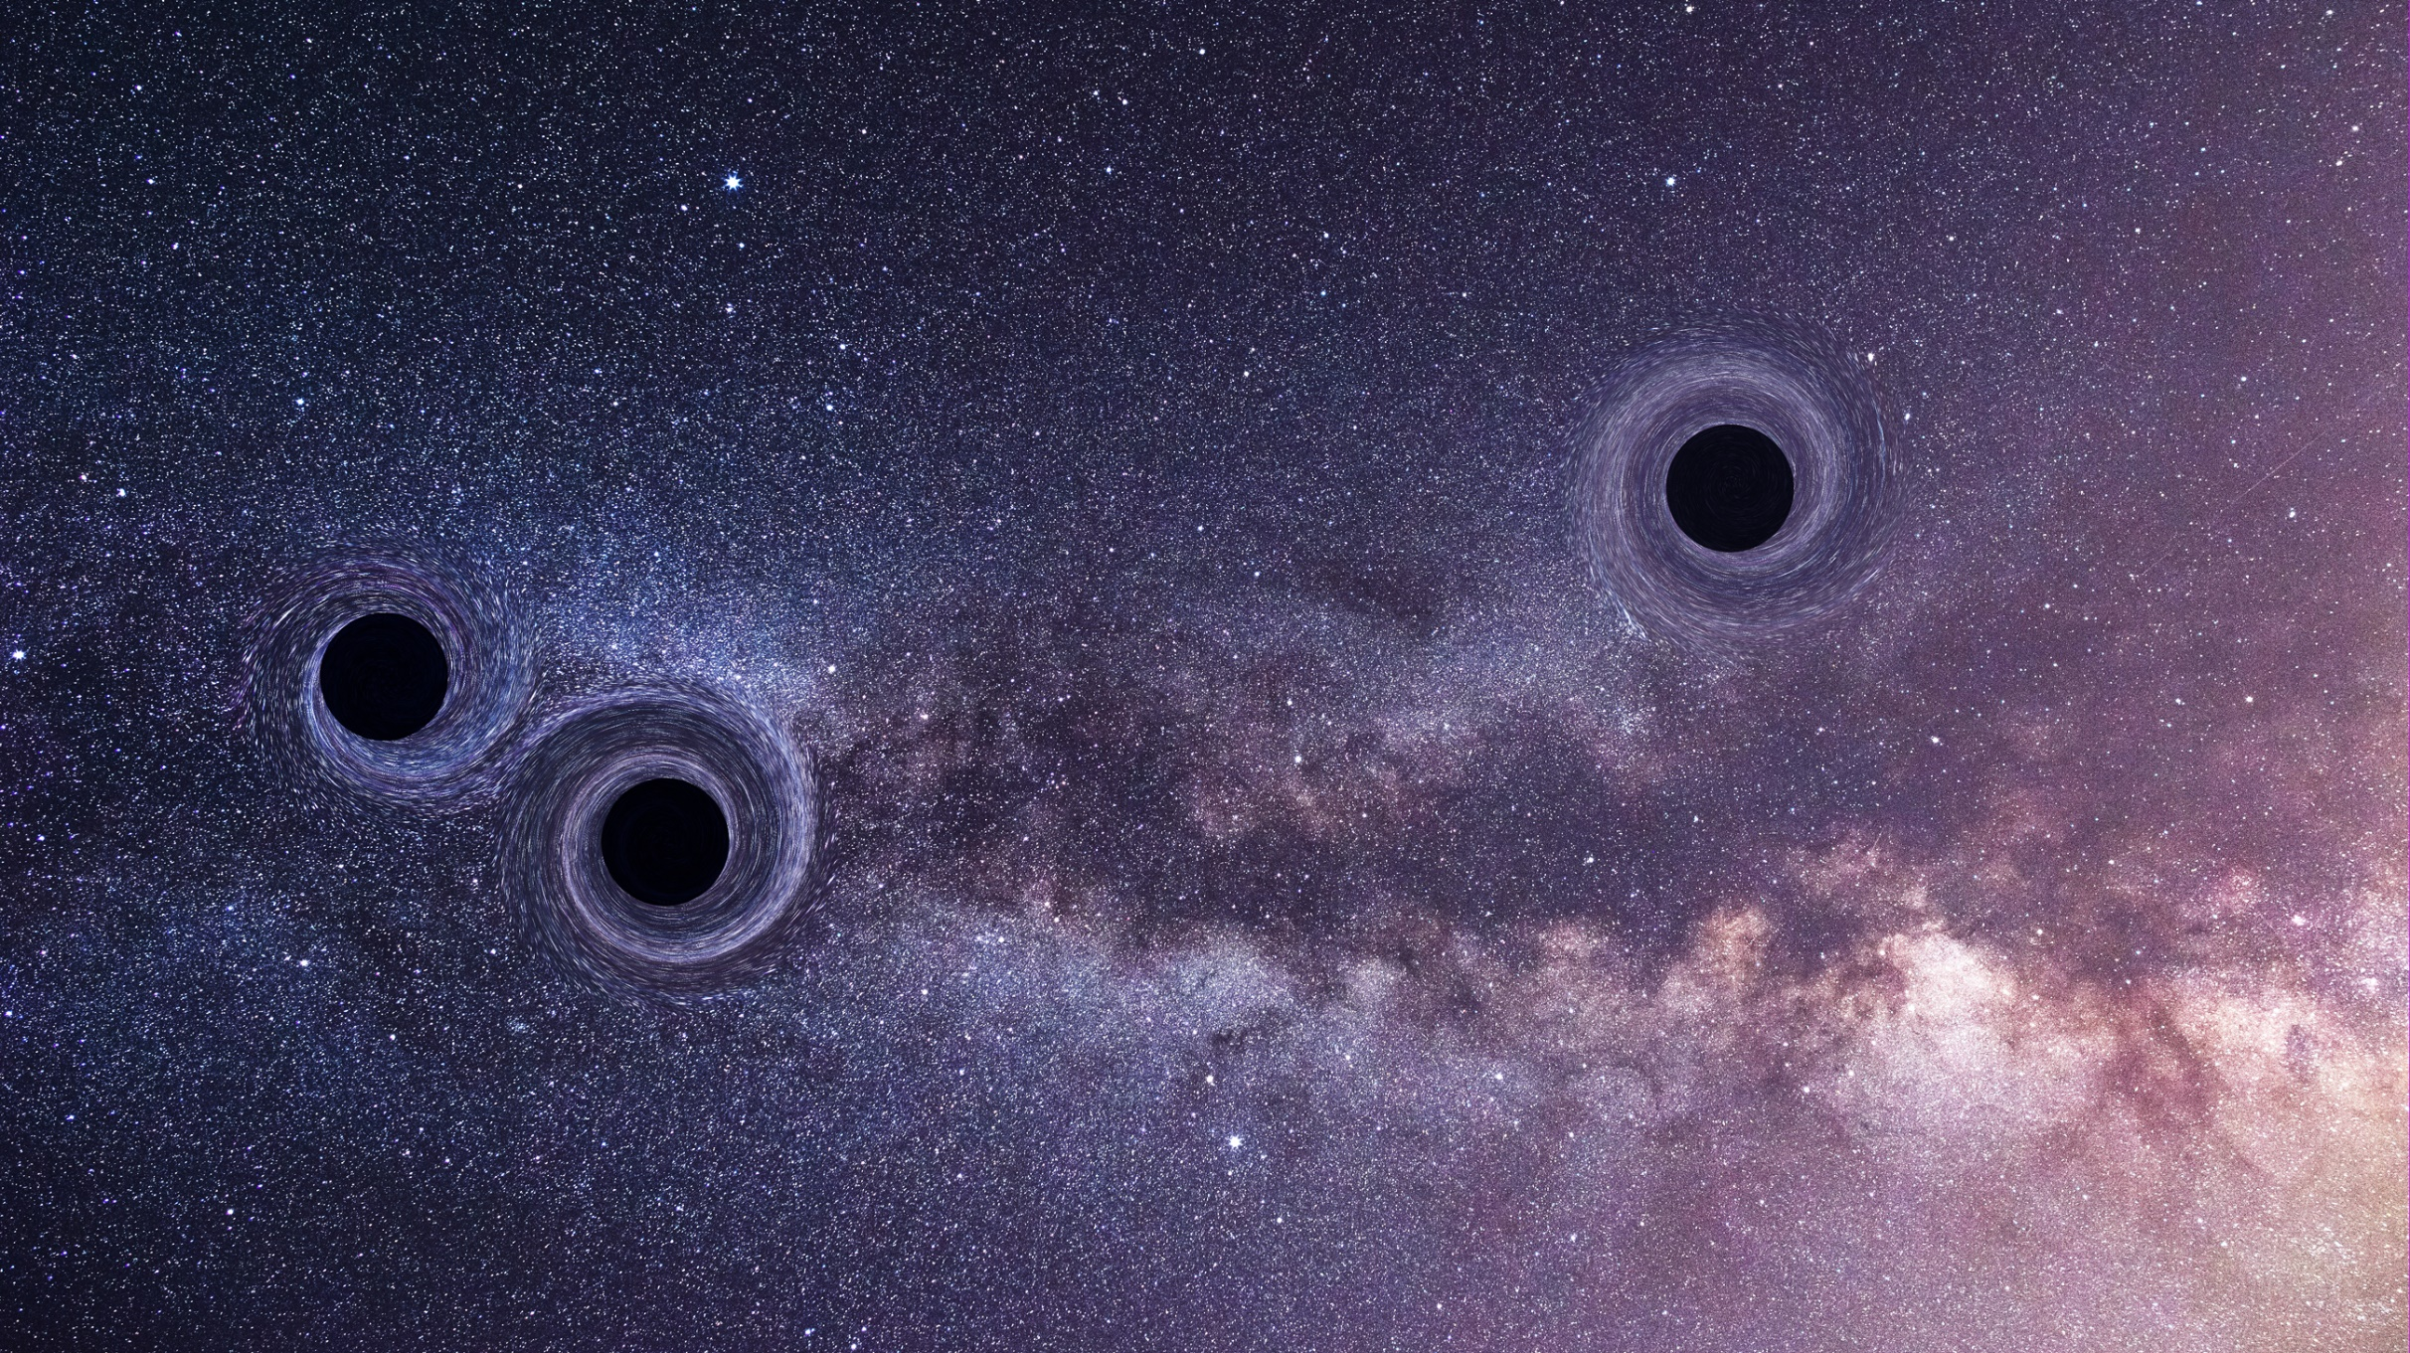
Thank You for Your Attention
Notes:
So in total, all I do is just to try and understand the way our universe evolved in its very early stages, the dark ages! No name age!
Finding the exact astrophysical scenario may result in generating a very different understanding of the mechanisms which formed our universe. So, we are all very excited to see the results of this research.

